Slide 1
Chatbot ethical and legal considerations (2025)

Slide 2
Overview
AI ethics and regulation materials published by :
Office Of the Privacy Commissioner for Personal Data (PCPD)
AI Security
Digital Policy Office
Data privacy and generative AI guidelines

Slide 3
Overview
AI ethics and regulation materials published by:
Cyberspace Administration of China (CAC), the People’s Republic of China
Global AI Governance Initiative (2023)
https://www.mfa.gov.cn/eng/zy/gb/202405/t20240531_11367503.html
European Parliament and Council
Regulation (EU) 2024/1689 – AI Act (European Union)
https://eur-lex.europa.eu/eli/reg/2024/1689/oj/eng
US
State-level AI legislation also shows significant differences (Hong Kong Generative Artificial Intelligence Technical and Application Guideline)

Slide 4
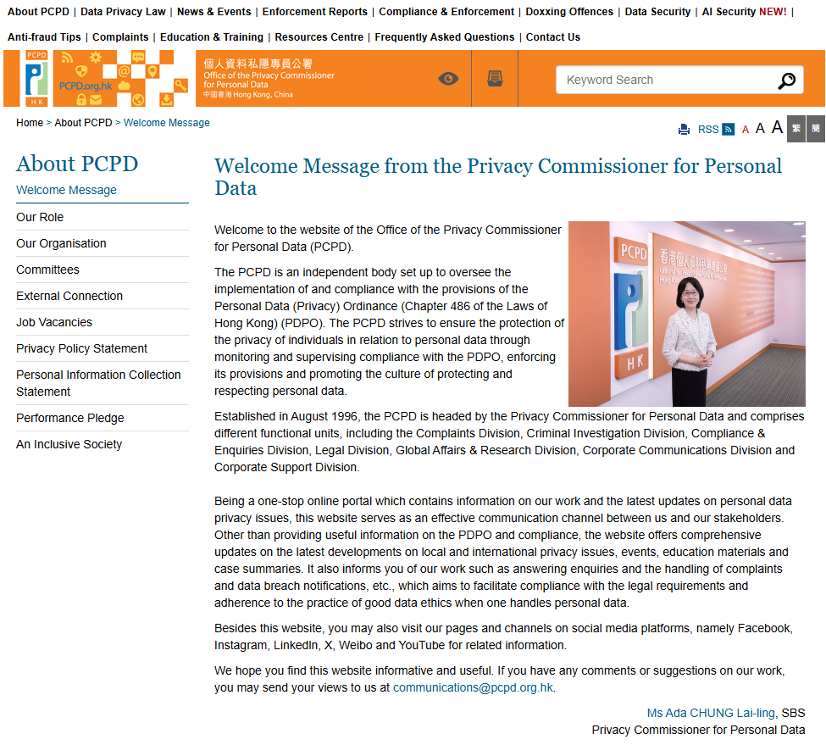
Office Of the Privacy Commissioner for Personal Data
https://www.pcpd.org.hk/english/about_pcpd/commissioner/commissioner.html

Slide 5
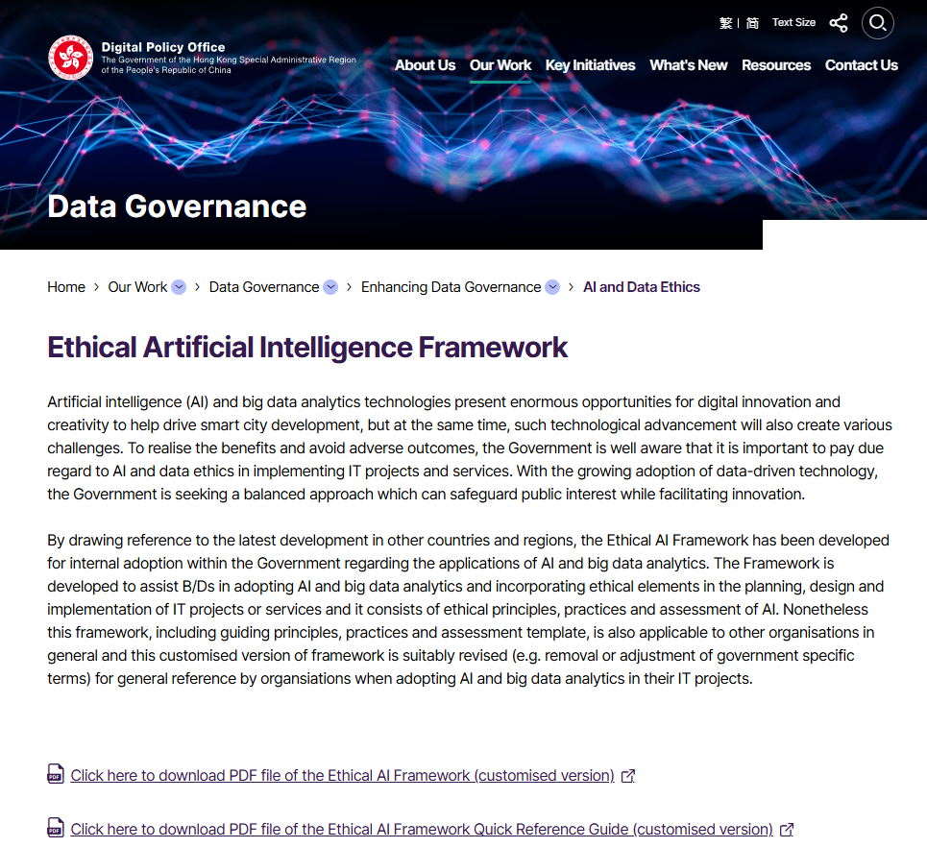
Digital Policy Office
https://www.digitalpolicy.gov.hk/en/our_work/data_governance/policies_standards/ethical_ai_framework/

Slide 6
PCPD
https://www.pcpd.org.hk/english/about_pcpd/commissioner/commissioner.html

Slide 7
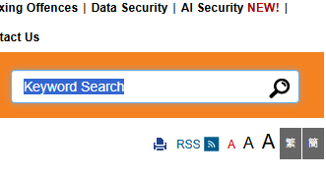
PCPD: AI Security

Slide 8
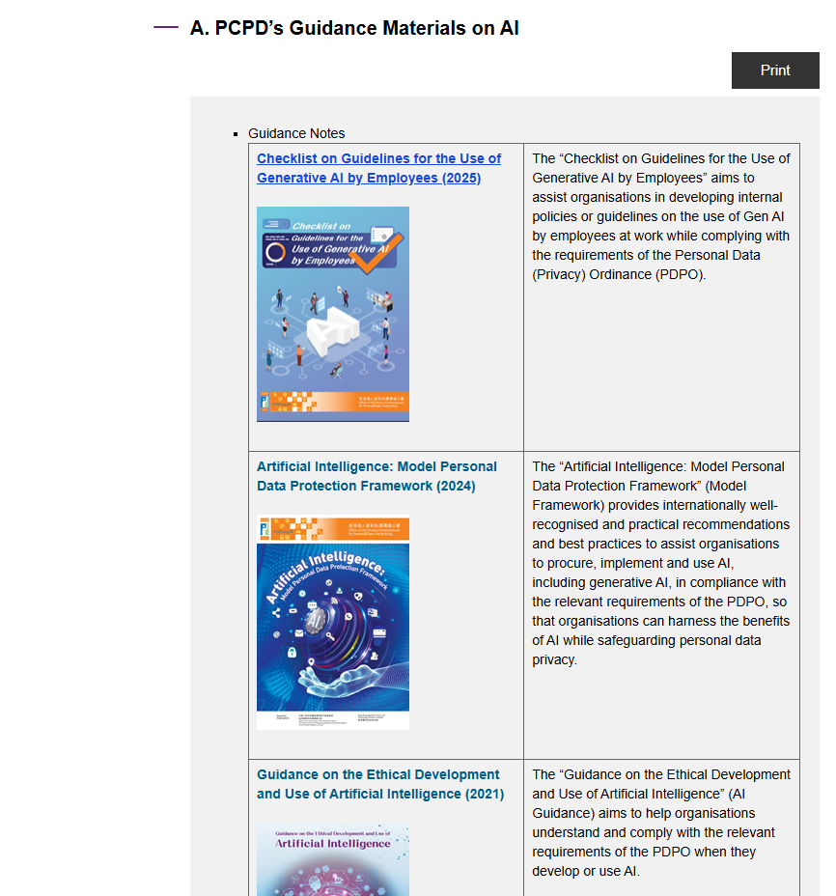
PCPD : AI Security

Slide 9
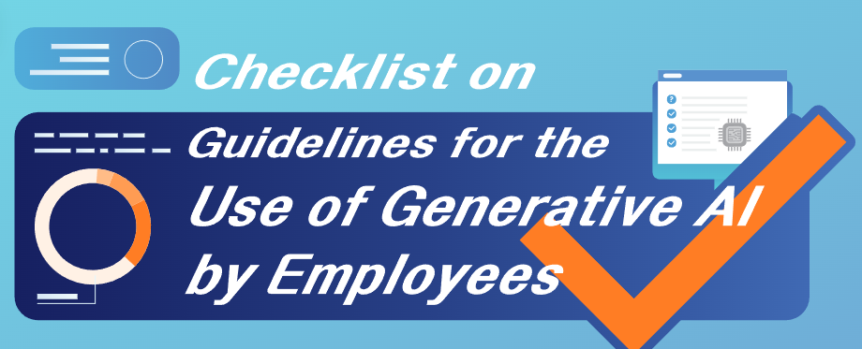
PCPD: Guidelines for the user of Generative AI by Employees

Slide 10
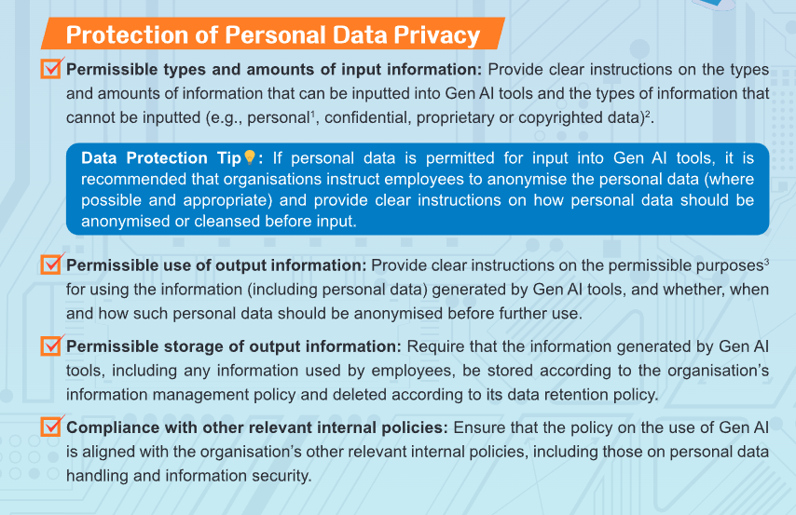
PCPD : Guidelines for the user of Generative AI by Employees

Slide 11

Data collection

Slide 12
PCPD : Data collection
Collecting an adequate but not excessive amount of personal data by lawful and fair means;
Refraining from using personal data for any purpose that is not compatible with the original purpose of collection, unless express and voluntary consents of the data subjects have been obtained, or the personal data has been anonymized
Please refer to https://www.pcpd.org.hk/english/resources_centre/publications/files/guidance_ethical_e.pdf
https://www.pcpd.org.hk/english/resources_centre/publications/files/guidance_ethical_e.pdf

Slide 13
PCPD : Data collection
Taking all practicable steps to ensure the accuracy of personal data before use
Taking all practicable steps to ensure the security of personal data
Erasing or anonymising personal data when the original purpose of collection has been achieved
Please refer to https://www.pcpd.org.hk/english/resources_centre/publications/files/guidance_ethical_e.pdf
https://www.pcpd.org.hk/english/resources_centre/publications/files/guidance_ethical_e.pdf

Slide 14

Data protection

Slide 15
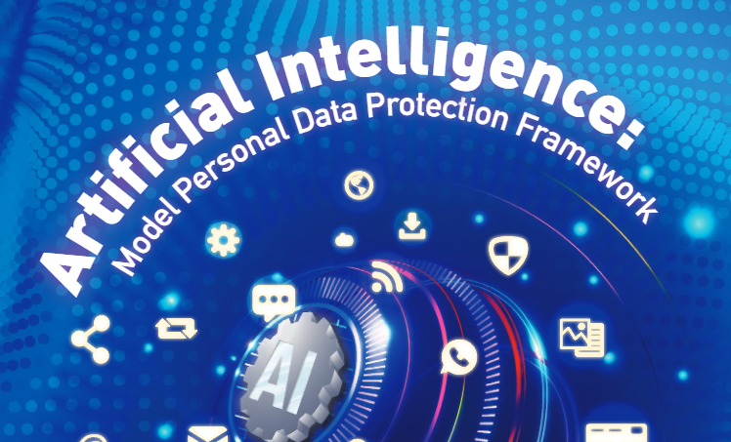
PCPD – AI: Model Personal Data Protection Framework

Slide 16
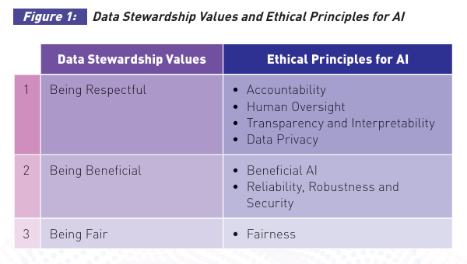
PCPD – AI: Model Personal Data Protection Framework

Slide 17
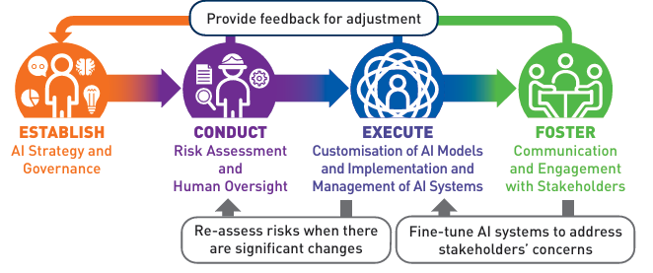
PCPD – AI: Model Personal Data Protection Framework
In general, organisations sourcing third-party AI solutions should adopt a risk-based approach to procuring, implementing and using AI systems, as part of a broader, holistic approach to AI governance in their organisations

Slide 18
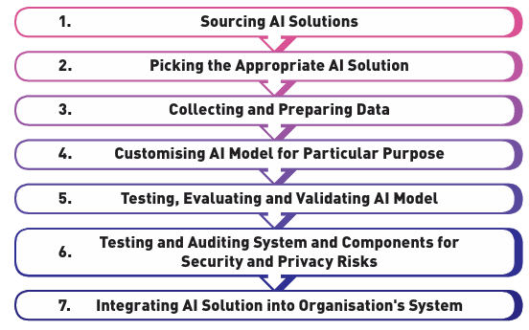
PCPD – AI: Model Personal Data Protection Framework
Process of Procurement and Implementation of AI Models

Slide 19
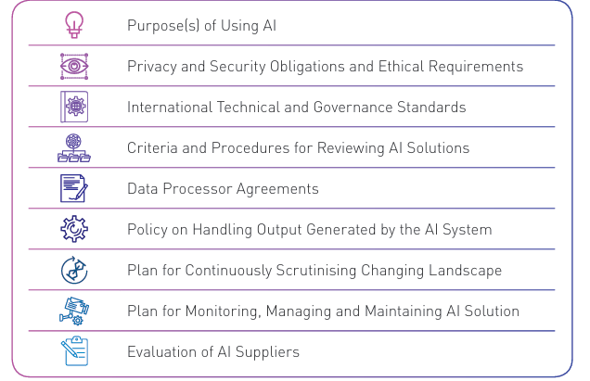
PCPD – AI: Model Personal Data Protection Framework
Governance Considerations for Procuring AI Solutions

Slide 20
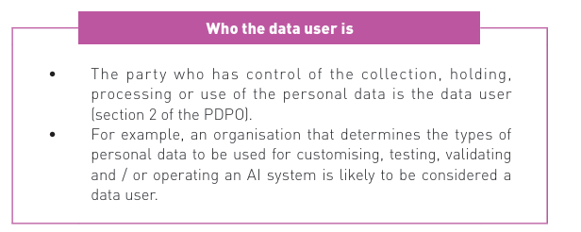
PCPD – AI: Model Personal Data Protection Framework
Key Data (Including Personal Data) Protection Compliance Considerations (Non-exhaustive)

Slide 21
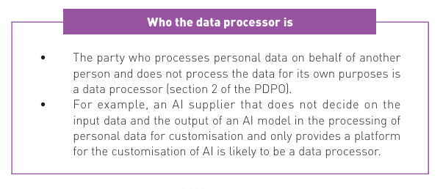
PCPD – AI: Model Personal Data Protection Framework
Key Data (Including Personal Data) Protection Compliance Considerations (Non-exhaustive)

Slide 22
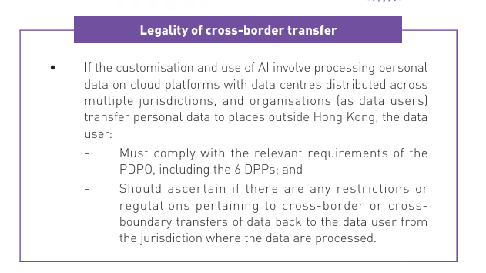
PCPD – AI: Model Personal Data Protection Framework
Key Data (Including Personal Data) Protection Compliance Considerations (Non-exhaustive)

Slide 23
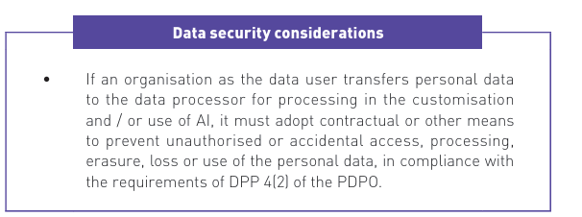
PCPD – AI: Model Personal Data Protection Framework
Key Data (Including Personal Data) Protection Compliance Considerations (Non-exhaustive)

Slide 24
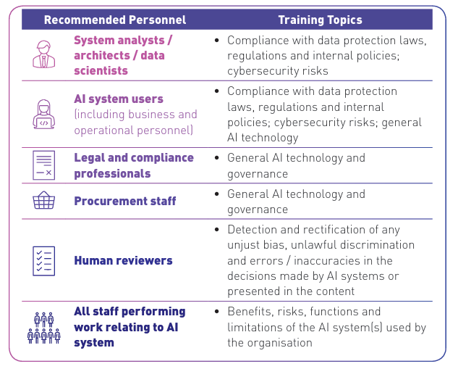
PCPD – AI: Model Personal Data Protection Framework
Examples of Training
Training and Awareness Raising
To ensure that AI-related policies are properly applied, adequate training should be provided to all relevant personnel to ensure that they have the appropriate knowledge, skills and awareness to work in an environment using AI systems.

Slide 25
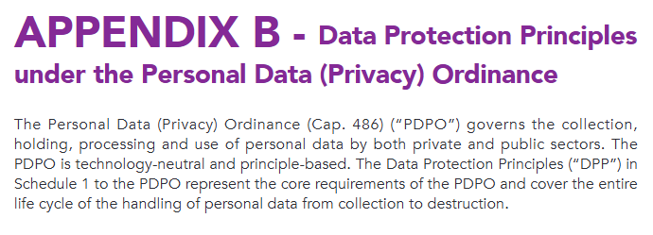
PCPD: Data Protection Principles
https://www.pcpd.org.hk/english/resources_centre/publications/files/guidance_ethical_e.pdf

Slide 26
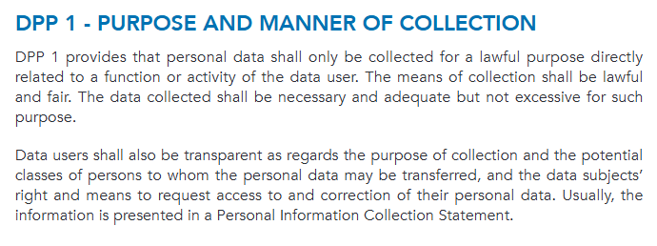
PCPD: Data Protection Principles 1
https://www.pcpd.org.hk/english/resources_centre/publications/files/guidance_ethical_e.pdf

Slide 27
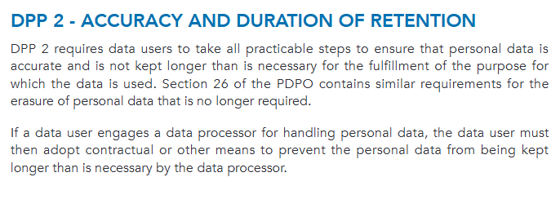
PCPD: Data Protection Principles 2
https://www.pcpd.org.hk/english/resources_centre/publications/files/guidance_ethical_e.pdf

Slide 28
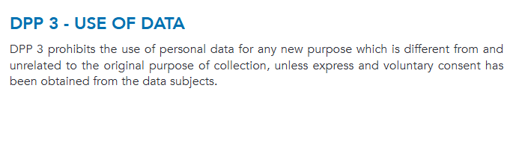
PCPD: Data Protection Principles 3
https://www.pcpd.org.hk/english/resources_centre/publications/files/guidance_ethical_e.pdf

Slide 29
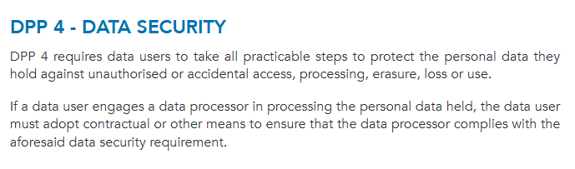
PCPD: Data Protection Principles 4
https://www.pcpd.org.hk/english/resources_centre/publications/files/guidance_ethical_e.pdf

Slide 30
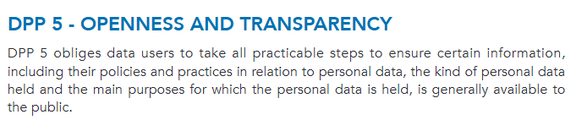
PCPD: Data Protection Principles 5
https://www.pcpd.org.hk/english/resources_centre/publications/files/guidance_ethical_e.pdf

Slide 31
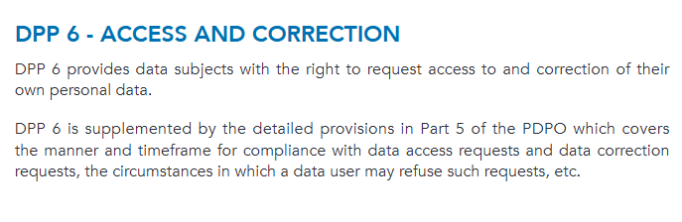
PCPD: Data Protection Principles 6
https://www.pcpd.org.hk/english/resources_centre/publications/files/guidance_ethical_e.pdf

Slide 32
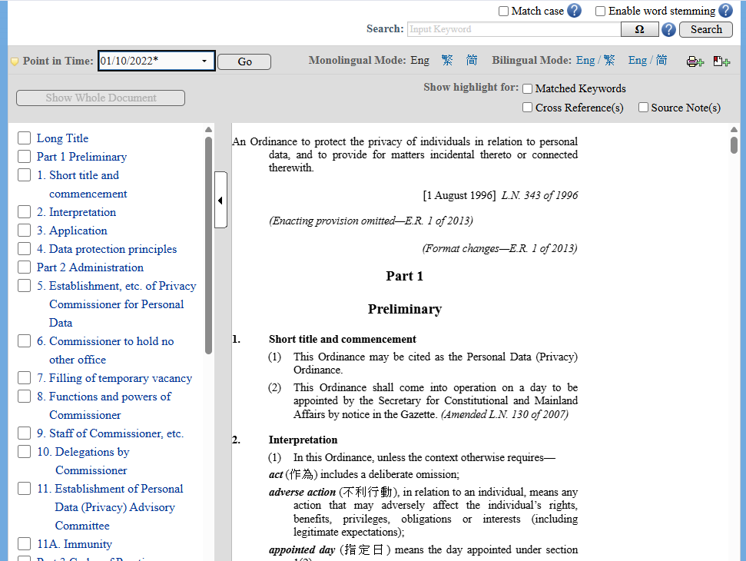
Personal Data (Privacy) Ordinance (Cap. 486)
https://www.elegislation.gov.hk/hk/cap486

Slide 33

Risk level

Slide 34
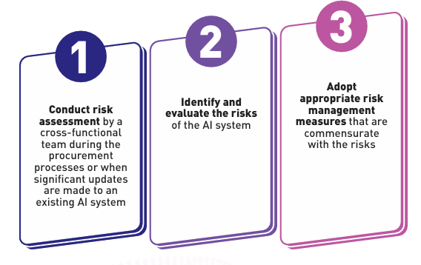
PCPD – AI: Process of Risk Assessment
Comprehensive risk assessment is necessary for organisations to systematically identify, analyse and evaluate the risks, including privacy risks, involved in the procurement, use and management of AI systems

Slide 35
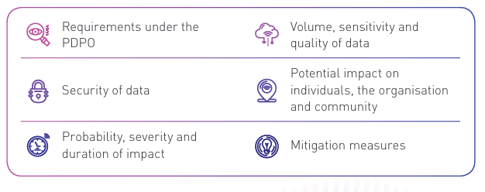
PCPD – AI: Factors to Consider in Risk Assessment of AI Systems (Non-exhaustive)

Slide 36
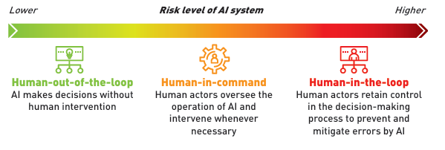
PCPD – AI: Determining the Level of Human Oversight
In adopting a risk-based approach, the types and extent of risk mitigation measures should correspond with and be proportionate to the levels of the identified risks.
Risk-based Approach to Human Oversight:

Slide 37
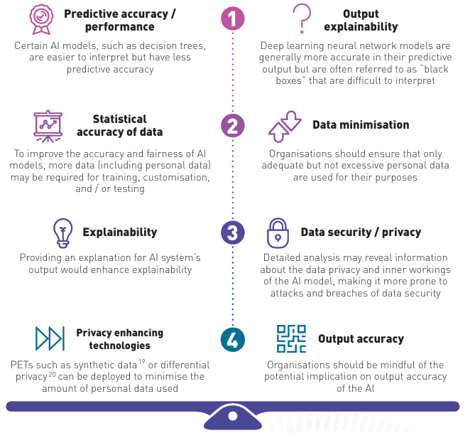
PCPD – AI: Examples of Risk Mitigation Trade-offs

Slide 38
Digital Policy Office
https://www.digitalpolicy.gov.hk/en/our_work/data_governance/policies_standards/ethical_ai_framework/

Slide 39
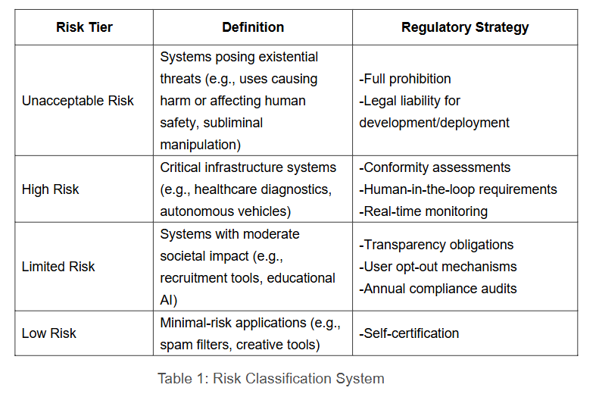
Digital Policy Office: Risks

Slide 40
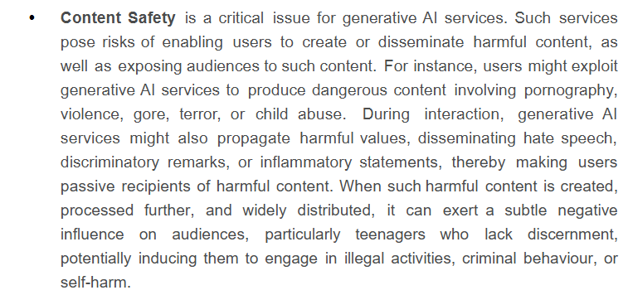
Digital Policy Office: Safety Risks
Even at the service stage, generative AI can still introduce new safety risks.

Slide 41
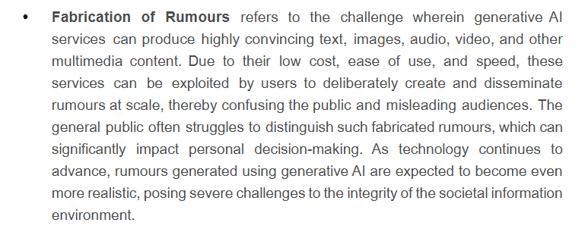
Digital Policy Office: Safety Risks

Slide 42
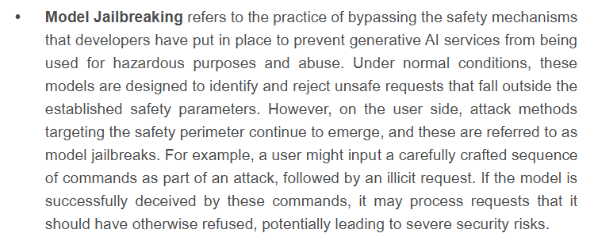
Digital Policy Office: Safety Risks

Slide 43
Digital Policy Office: Safety Risks
Data Leaks refer to the challenge wherein generative AI services, particularly chat-based services, may collect user information in various forms. This includes information voluntarily provided by users, uploaded documents, and personal data accessed through devices. During the transmission and processing of this data, there is a risk of exposing private information belonging to individuals or enterprise users.

Slide 44
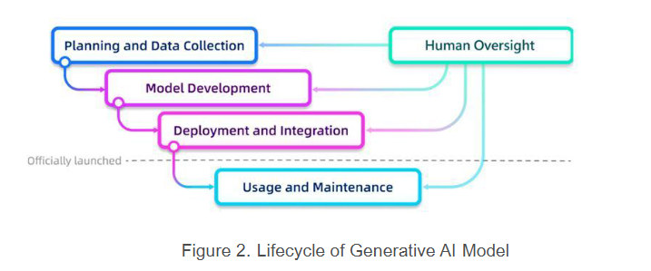
Digital Policy Office: Lifecycle of Generative AI Model

Slide 45
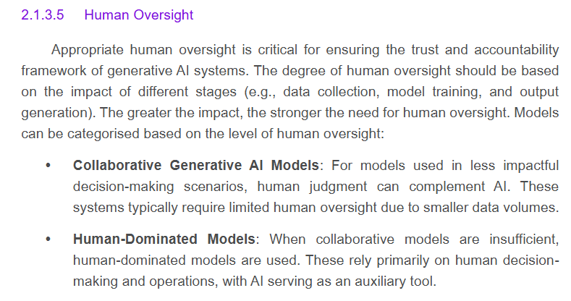
Digital Policy Office: Human Oversight

Slide 46

Industry-Oriented Trustworthy AI Principles in Hong Kong

Slide 47
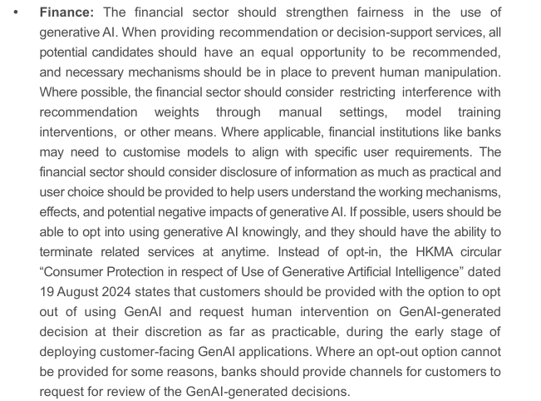
Digital Policy Office: Finance
Hong Kong Generative Artificial Intelligence Technical and Application Guideline

Slide 48
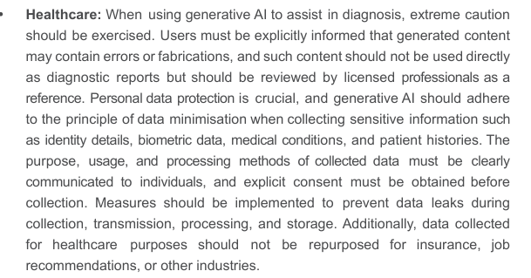
Digital Policy Office: Healthcare
Hong Kong Generative Artificial Intelligence Technical and Application Guideline

Slide 49
Digital Policy Office: Legal
Legal:
In the legal industry, the accuracy and reliability of generative AI outputs must be ensured, and generated content should include citations that trace back to the original legal texts. AI-generated content should not be used directly as legal documents but should serve as a reference after review by legal professionals. To protect personal data, sensitive legal cases involving trade secrets or private information should not be processed using public AI services that lack security and confidentiality guarantees.
Hong Kong Generative Artificial Intelligence Technical and Application Guideline

Slide 50
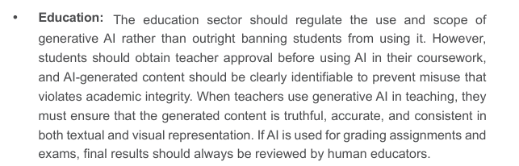
Digital Policy Office: Education
Hong Kong Generative Artificial Intelligence Technical and Application Guideline

Slide 51
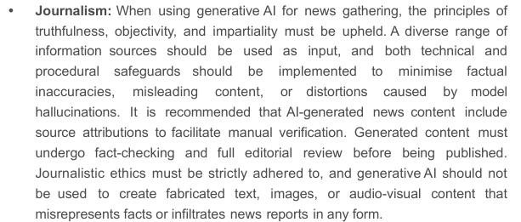
Digital Policy Office: Journalism
Hong Kong Generative Artificial Intelligence Technical and Application Guideline

Slide 52
Digital Policy Office: Retail
Retail: Retail businesses using generative AI for product recommendations, dynamic pricing, or customer service must ensure that algorithmic outcomes remain fair and transparent across different customer segments and geographic locations, maintaining market fairness. When collecting customer preferences and purchasing behaviour, businesses must comply with data protection and privacy regulations while conducting personalised marketing and promotions. To address customer concerns or confusion regarding generative AI, human support and real-time response mechanisms should be available to safeguard consumer rights.
Hong Kong Generative Artificial Intelligence Technical and Application Guideline

Slide 53
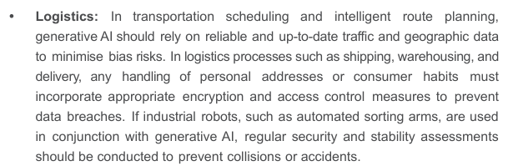
Digital Policy Office: Logistics
Hong Kong Generative Artificial Intelligence Technical and Application Guideline

Slide 54
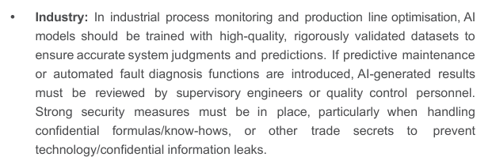
Digital Policy Office: Industry
Hong Kong Generative Artificial Intelligence Technical and Application Guideline

